Slide 1
DIYALA UNIVERSITY
COLLEGE OF ENGINEERING
DEPARTMENT OF COMMUNICATION ENGINEERING
Electronic I
By
Asst. lecturer
WISAM HAYDER MAHDI
Lecture 1
Notes:
aaa

Slide 2
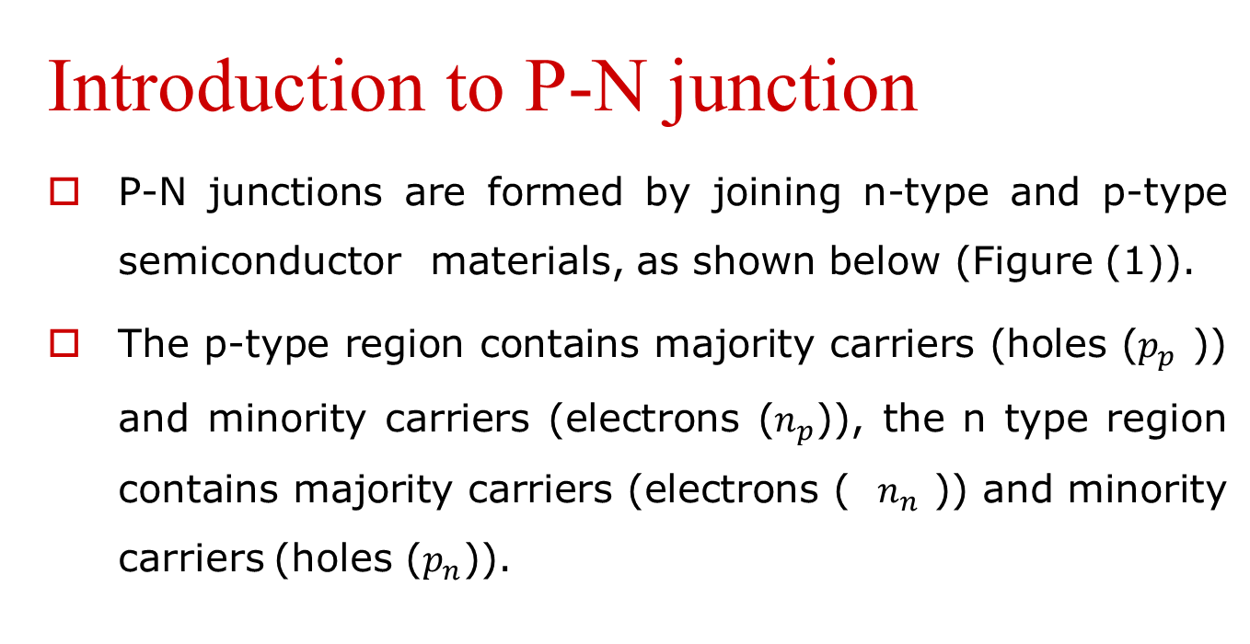
P–N Junction
Introduction to P-N junction
P-N junctions are formed by joining n-type and p-type semiconductor materials, as shown below (Figure (1)).
The p-type region contains majority carriers (holes ($p_{p}$ )) and minority carriers (electrons ($n_{p}$)), the n type region contains majority carriers (electrons ( $n_{n}$ )) and minority carriers (holes ($p_{n}$)).

Slide 3
P–N Junction
Since the n-type region has a high electron concentration and the p-type has a high hole concentration, electrons diffuse from the n-type side to the p-type side.
Similarly, holes flow by diffusion from the p-type side to the n-type side.
When the electrons and holes move to the other side of the junction, they leave behind exposed charges on dopant atom sites, which are fixed in the crystal lattice and are unable to move.

Slide 4
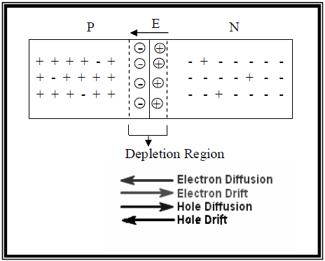
P–N Junction
On the n-type side, positive ion cores are exposed. On the p-type side, negative ion cores are exposed.
Figure (1): P-N junction.

Slide 5
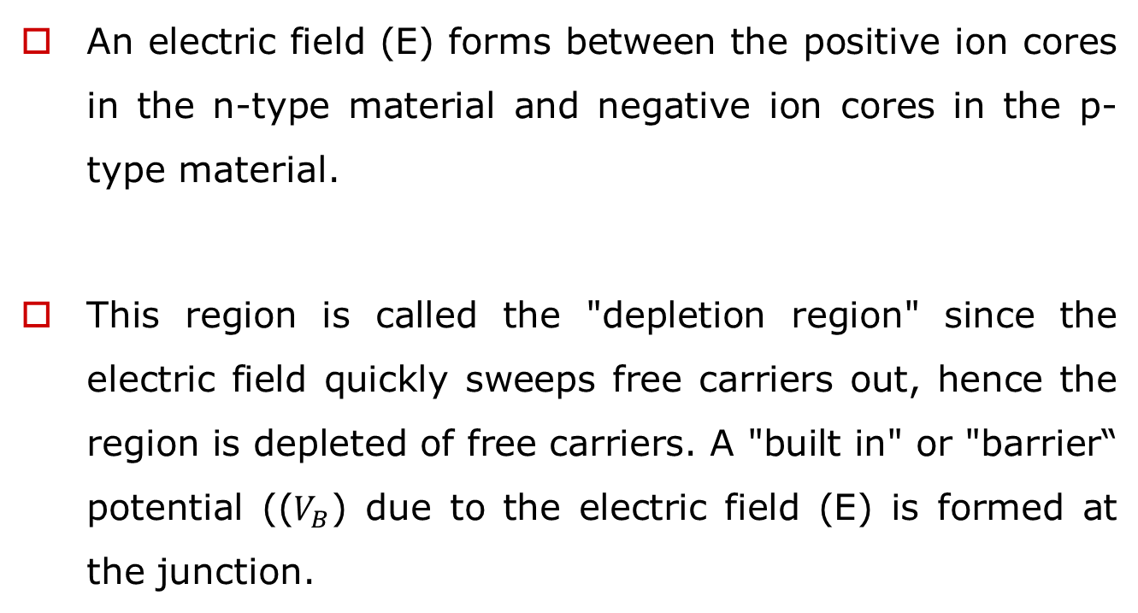
P–N Junction
An electric field (E) forms between the positive ion cores in the n-type material and negative ion cores in the p-type material.
This region is called the "depletion region" since the electric field quickly sweeps free carriers out, hence the region is depleted of free carriers. A "built in" or "barrier“ potential (($V_{B}$) due to the electric field (E) is formed at the junction.

Slide 6
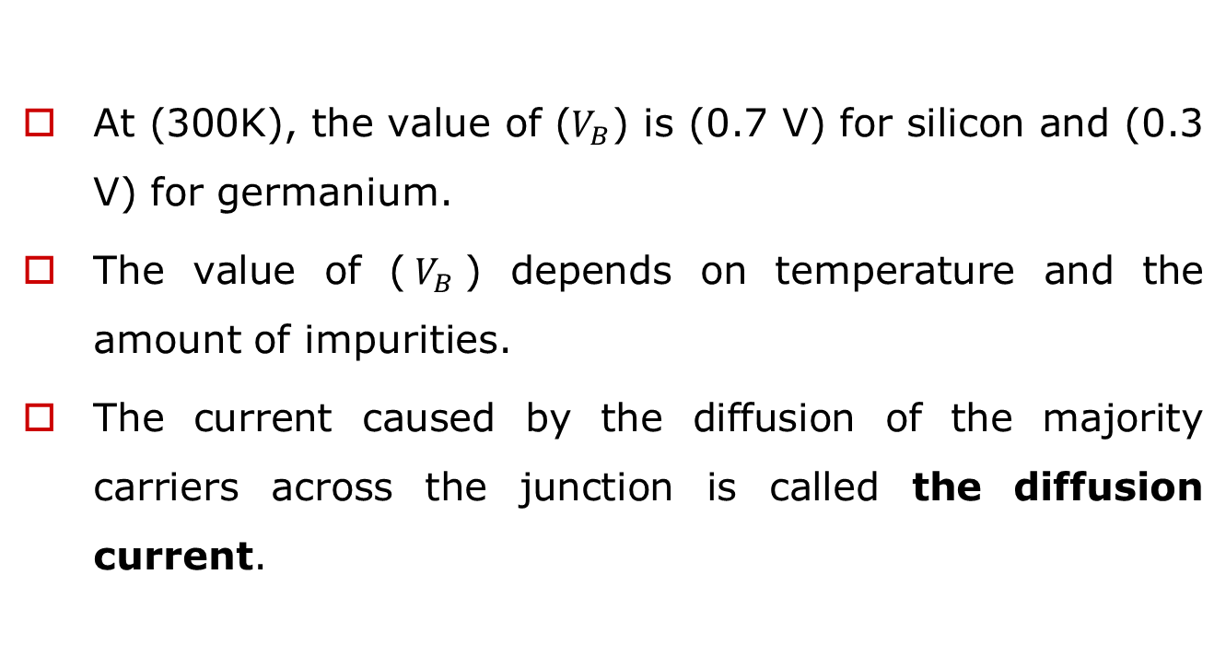
P–N Junction
At (300K), the value of ($V_{B}$) is (0.7 V) for silicon and (0.3 V) for germanium.
The value of ($V_{B}$) depends on temperature and the amount of impurities.
The current caused by the diffusion of the majority carriers across the junction is called the diffusion current.

Slide 7
P–N Junction
Minority carriers which reach the edge of the depletion region are swept across it by the electric field in the depletion region.
This current is called the drift current.
In equilibrium, the net current from the device is zero.
The electron drift current and the electron diffusion current exactly balance out. Similarly, the hole drift current and the hole diffusion current also balance each other out.

Slide 8
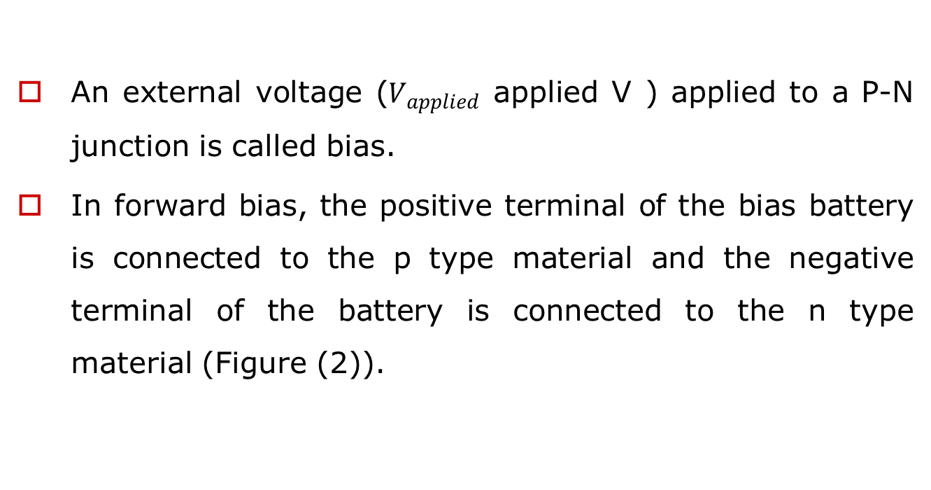
Forward Bias for P-N Junction:
An external voltage ($V_{applied}$ applied V ) applied to a P-N junction is called bias.
In forward bias, the positive terminal of the bias battery is connected to the p type material and the negative terminal of the battery is connected to the n type material (Figure (2)).

Slide 9
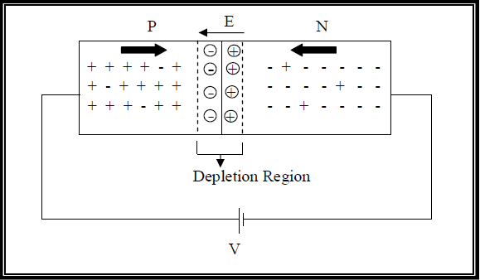
Forward Bias for P-N Junction:
Figure (2): Forward Bias for P-N Junction.

Slide 10
Forward Bias for P-N Junction:
The positive potential repels holes toward the junction; at the same time, the negative potential repels electrons toward the junction, therefore, the width of the depletion region decreases.
The current resulting from the movement of the holes and the electrons is called the forward current.

Slide 11
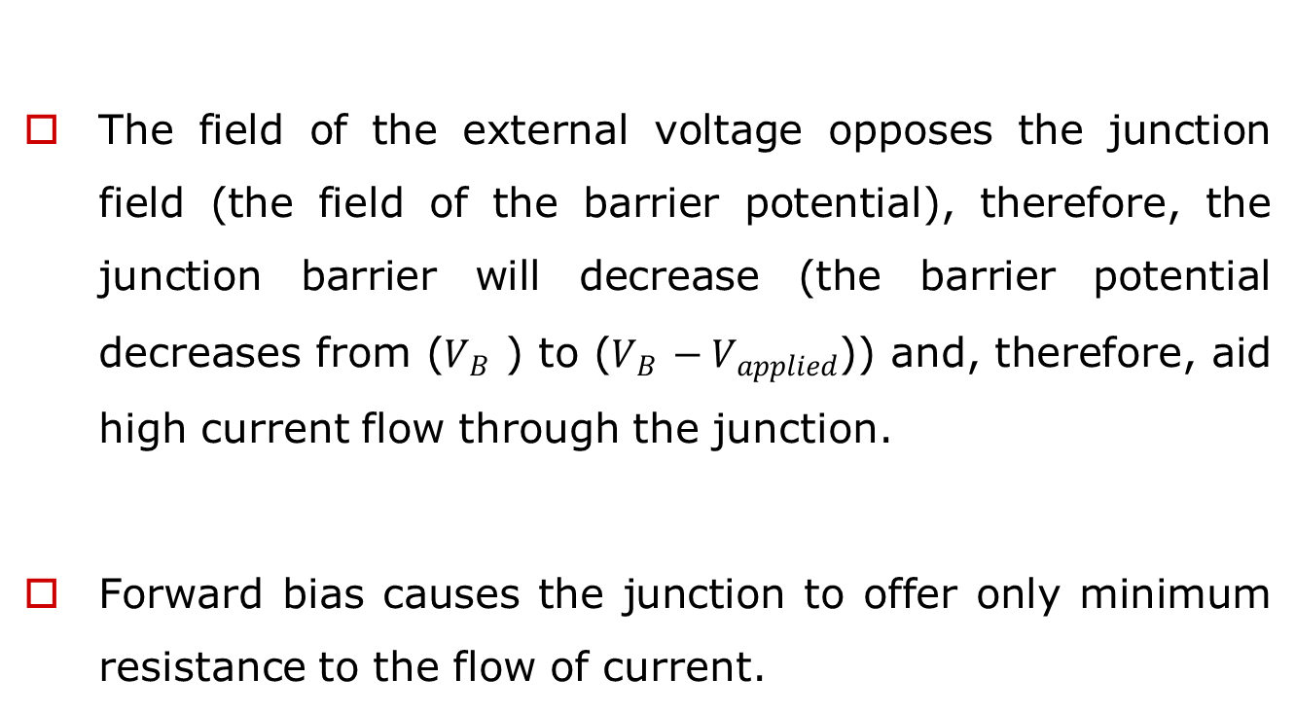
Forward Bias for P-N Junction:
The field of the external voltage opposes the junction field (the field of the barrier potential), therefore, the junction barrier will decrease (the barrier potential decreases from ($V_{B}$ ) to ($V_{B}$ $− V_{applied}$)) and, therefore, aid high current flow through the junction.
Forward bias causes the junction to offer only minimum resistance to the flow of current.

Slide 12
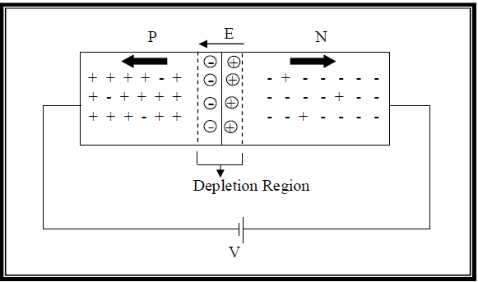
Reverse Bias for P-N Junction:
The negative battery terminal is connected to the p-type material, and the positive battery terminal to the n- type material (Figure (3)).
Figure (3): Reverse Bias for P-N Junction.

Slide 13
Reverse Bias for P-N Junction:
The negative potential attracts the holes away from the edge of the junction barrier on the p side, while the positive potential attracts the electrons away from the edge of the barrier on the n side.
This action increases the depletion region width.

Slide 14
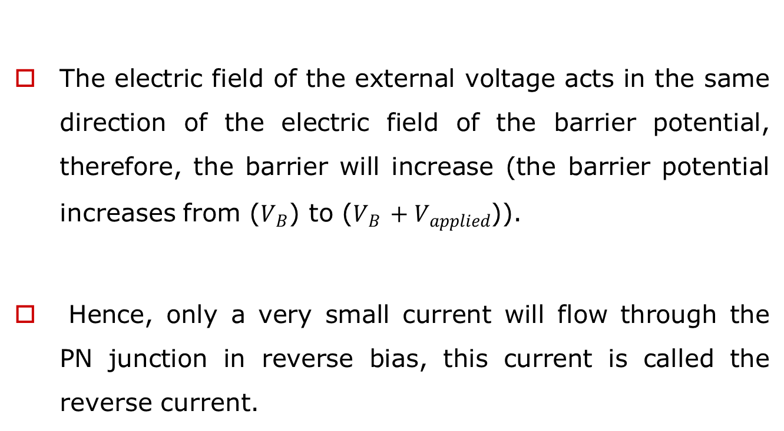
Reverse Bias for P-N Junction:
The electric field of the external voltage acts in the same direction of the electric field of the barrier potential, therefore, the barrier will increase (the barrier potential increases from ($V_{B}$) to ($V_{B}$ $+ V_{applied}$)).
Hence, only a very small current will flow through the PN junction in reverse bias, this current is called the reverse current.

Slide 15
The Diode:
A diode is a two-terminal electronic component that conducts electric current in only one direction.
The most common function of a diode is to allow an electric current to pass in one direction (called the diode's forward direction) while blocking current in the opposite direction (the reverse direction).

Slide 16
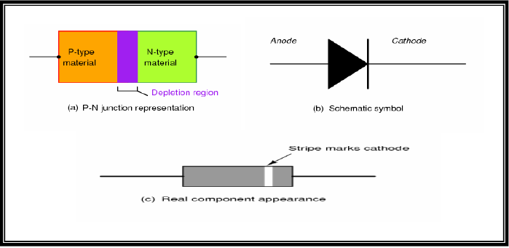
The Diode:
Figure (4): Diode representations.

Slide 17
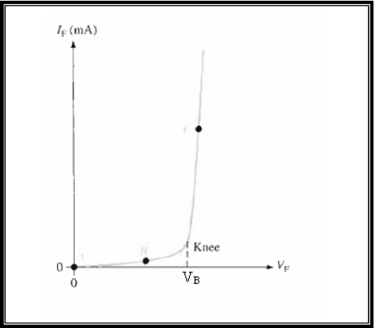
Voltage-Current Characteristic of a Diode:
V-I Characteristic for Forward Bias:
Figure (5): V-I characteristic
curve for a forward-biased diode.

Slide 18
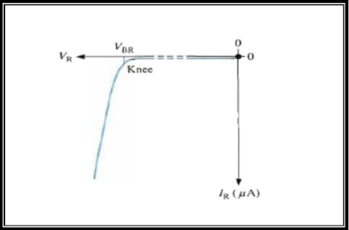
Voltage-Current Characteristic of a Diode:
V-I Characteristic for Reverse Bias:
Figure (6): V-I characteristic curve for a reverse-biased diode.

Slide 19
The Complete V-I Characteristic Curve:
The Complete V-I Characteristic Curve:
Combine the curves for both forward and reverse bias to get the complete curve as shown in figure (7). Notice that the (IF) scale is in (mA) compared to the (IR) scale in (μA ).

Slide 20
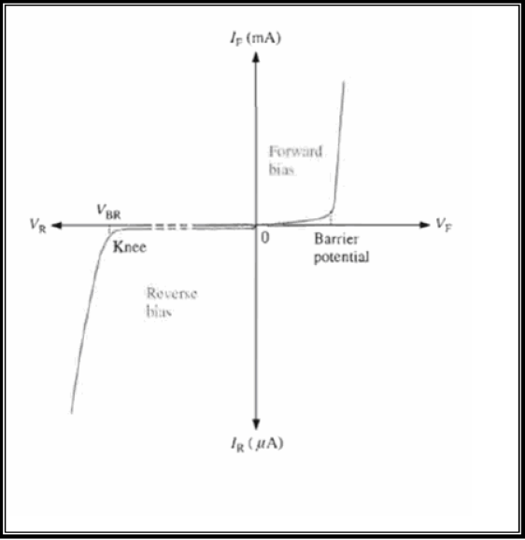
The Complete V-I Characteristic Curve:
Figure (7): The complete V-I characteristic curve for a diode.

Slide 21
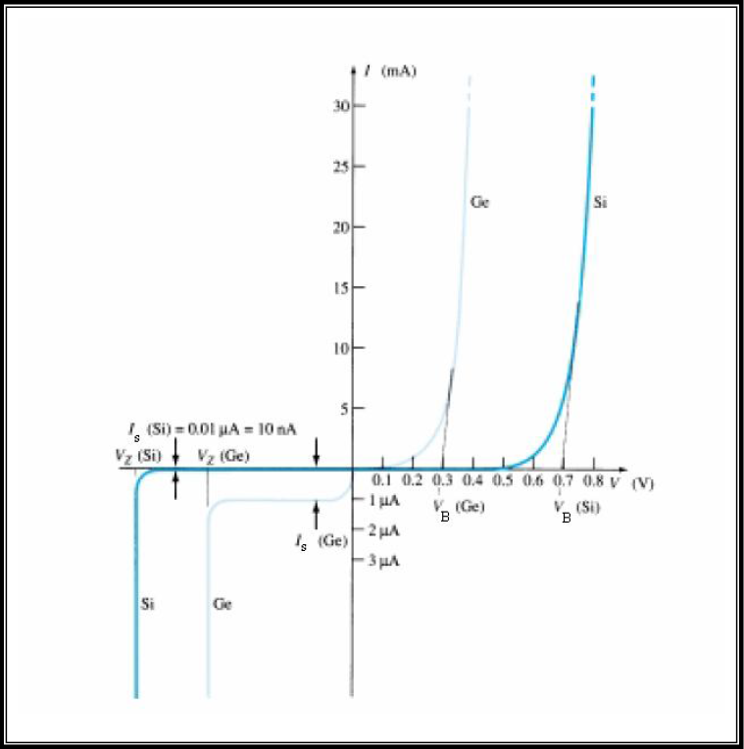
The Complete V-I Characteristic Curve:
Figure (8): Comparison between the V-I characteristic curve for silicon diode and germanium diode.

Slide 22
Introduction
The Bipolar Junction Transistor (BJT)
The transistor, derived from transfer resistor, is a three
terminal device whose resistance between two terminals is
controlled by the third.
The term bipolar reflects the fact that there are two types of carriers, holes and electrons which form the currents in the transistor.
If only one carrier is employed (electron or hole), it is considered a unipolar device like field effect transistor (FET).

Slide 23
Introduction
The transistor is constructed with three doped semiconductor regions separated by two pn junctions.
The three regions are called Emitter (E), Base (B), and Collector (C).
Physical representations of the two types of BJTs are shown in Figure (1–1). One type consists of two n -regions separated by a p-region (npn), and the other type consists of two p-regions separated by an n-region (pnp).

Slide 24
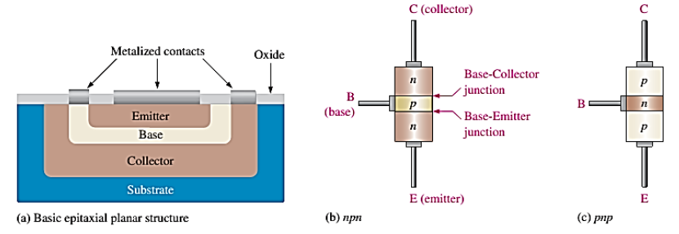
Introduction
Figure (1-1) Transistor Basic Structure

Slide 25
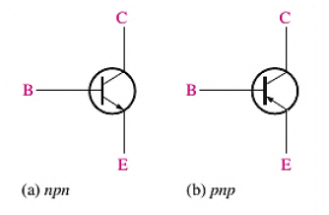
Introduction
Figure (1-2) shows the schematic symbols for the npn and pnp
Transistors.
Figure (1-2) standard transistor symbol

Slide 26
Transistor operation
Objective: understanding the basic operation of the transistor and its naming
In order for the transistor to operate properly as an amplifier, the two pn junctions must be correctly biased with external voltages.
The basic operation of the transistor will now be described using the npn transistor. The operation of the pnp transistor is the same as for the npn except that the roles of the electrons and holes, the bias voltage polarities and current directions are all reversed.

Slide 27
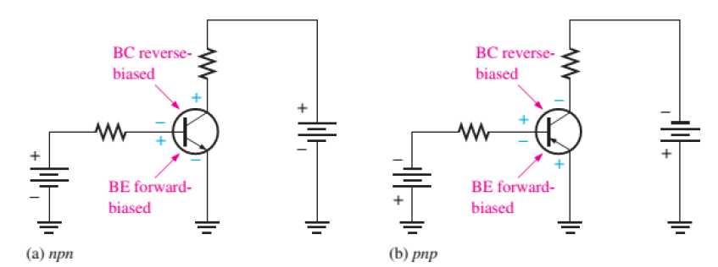
Transistor operation
Figure (1-3) shows both the pnp and npn transistors with the proper DC biasing. Notice that in both cases the base-emitter junction is forward biased and the base-collector is reverse biased.
Figure (1-3) transistor forward reverse bias.

Slide 28
Transistor operation
Before the transistor is biased there are two depletion regions. What is happens inside the transistor when it is forward and reverse bias is the forward biased from the base to emitter narrows the BE depletion region as shown in figure (1-4).
This will result in a heavy flow of majority carriers (electrons) from the emitter to the base as indicated by the wide arrow.
The base region is slightly doped and very thin so that it has a very limited number of holes. Thus, only small percentage of all the electrons flowing across the BE junction combine with the available holes. These relatively few recombined electrons will form the small base current (IB).

Slide 29
Transistor operation
The reverse biased from base to collector widens the BC depletion region as shown in figure (1-4). Consider the similarity between this situation and that of the reversed biased diode. Recall that the flow of majority carriers is zero, resulting in only a minority carriers flow.
The free electrons move through the collector region, into the external circuit, and then return into the emitter region along with the base current, as indicated. The emitter current is slightly greater than the collector current because of the small base current that splits off from the total current injected into the base region from the emitter.

Slide 30
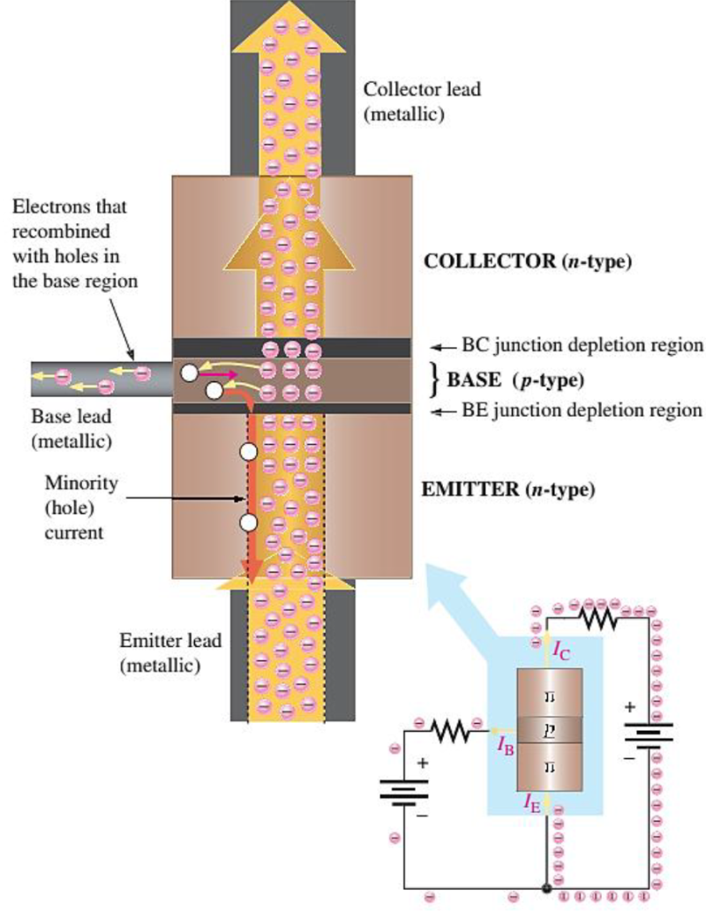
Transistor operation
Figure (1-4) transistor.
Notes:
aaa

